Slide 1
Lecture 4
Probabilistic Information Retrieval

Slide 2
Contents
Basic Probability Conception
Basic Probabilistic Principle
Binary Independence Retrieval

Slide 3
Probability: independent random variables and conditional probability
Notation
Let a, b be two events, with probability P(a) and P(b).
Independent events
The events a and b are independent if and only if:
P(a ∩ b) = P(b) P(a)
Conditional probability
P(a | b) is the probability of a given b, also called the conditional probability of a given b.
P(a | b) P(b) = P(a ∩ b) = P(b | a) P(a)

Slide 4
Probability Theory -- Bayesian Formulas
Notation
Let a, b be two events.
P(a | b) is the probability of a given b
Bayes Theorem
P(a | b) =
P(a | b) =
P(b | a) P(a)
P(b)
P(b | a) P(a)
where a is the event not a
P(b)

Slide 5
Contents
Basic Probability Conception
Basic Probabilistic Principle
Binary Independence Retrieval

Slide 6
Probabilistic Ranking
Basic concept:
"For a given query, if we know some documents that are relevant, terms that occur in those documents should be given greater weighting in searching for other relevant documents.
By making assumptions about the distribution of terms and applying Bayes Theorem, it is possible to derive weights theoretically."
Van Rijsbergen

Slide 7
Concept
R is a set of documents that are guessed to be relevant
NR is the complement of R.
1. Guess a preliminary probabilistic description of R and use it to retrieve a first set of documents.
2. Interact with the user to refine the description.
3. Repeat, thus generating a succession of approximations to R.

Slide 8
Probabilistic Principle
Basic concept:
The probability that a document is relevant to a query is assumed to depend on the terms in the query and the terms used to index the document, only.
Given a user query q, the ideal answer set, R, is the set of all relevant documents.
Given a user query q and a document d_{j} in the collection, the probabilistic model estimates the probability that the user will find d_{j} relevant, i.e., that d_{j} is a member of R.

Slide 9
Tasks of Ranking by Probability
1. Find out relevant documents.
2. Construct the probability estimation model.
3. Design the query-document similarity measure based on probability of a document belonging to the relevant set.
Our introduction will take at the inverse order, i.e., similarity measure->probability model ->relevant documents

Slide 10
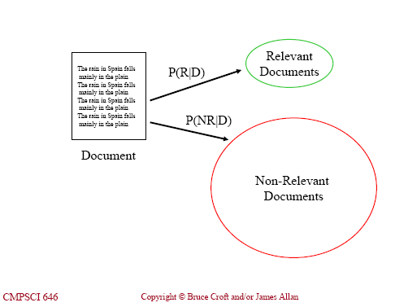
Probabilistic Principle
Similarity measure:
The similarity (d_{j}, q) is the ratio of the probability that d_{j} is relevant to q, to the probability that d_{j} is not relevant to q.
This measure runs from near zero, if the probability is small that the document is relevant, to large as the probability of relevance approaches one.

Slide 11
Probabilistic Principle
Given a query q and a document d_{j} the model needs an estimate of the probability that the user finds d_{j} relevant. i.e., P(R | d_{j}).
similarity (d_{j}, q) =
= by Bayes Theorem
= x k where k is constant
P(R | d_{j})
P(NR | d_{j})
Depend on query only
P(d_{j} | R) P(R)
P(d_{j} | NR) P(NR)
P(d_{j} | R)
P(d_{j} | NR)
P(d_{j} | R) is the probability of randomly selecting d_{j} from R.
Notes:
The detail discussion about the Probabilistic model starts from the definition of similarity.

Slide 12
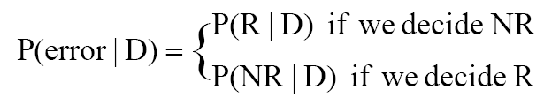
Basic Probabilistic Principle-Risk Minimization
Bayes Decision Rule: Retrieve if P(R|D) > P(NR|D)
minimizes the average probability of error:
equivalent to optimizing miss/ fallout tradeoff
In general we can associate a cost with each type of error
Derive a decision rule that minimizes risk
Expected loss when deciding on class is conditional risk

Slide 13
Risk Minimization
Risk of deciding relevant given D is
c_{rr}P(R|D) + c_{rn}P(NR|D)
c_{rr} is cost of deciding relevant when is relevant
c_{rn} is cost of deciding relevant when not relevant
similarly, risk of deciding non-relevant is
c_{nr}P(R|D) + c_{nn}P(NR|D)
How to decide the values of c_{rr}, c_{rn}, c_{nr} and c_{nn}?

Slide 14

Risk Minimization (Cont’d)
Minimizing risk gives
Want risk of choosing relevant to be less than that of choosing non-relevant
i.e., want that c_{rr}P(R|D) + c_{rn}P(NR|D) < c_{nr}P(R|D) + c_{nn}P(NR|D)
(c_{nr}-c_{rr})P(R|D) > (c_{rn}-c_{nn})P(NR|D)
So want O(R|D) = P(R|D) / P(NR|D) > (c_{rn}-c_{nn})/(c_{nr}-c_{rr})
As always, hard to estimate, so transform with Bayes’ theorem, so…
(c_{nr}-c_{rr}) P(D|R)P(R) > (c_{rn}-c_{nn}) P(D|NR)P(NR)
Likelihood ratio
P(D|R)/P(D|NR) > (c_{rn}-c_{nn})P(NR)/ (c_{nr}-c_{rr}) P(R)
retrieve when likelihood ratio greater than some threshold or, rank by likelihood ratio
typically c_{rr} = c_{nn} = 0 and c_{rn} = c_{nr} = 1
Tasks left are the estimations of P(D|R) and P(D|NR).

Slide 15
Contents
Basic Probability Conception
Basic Probabilistic Principle
Binary Independence Retrieval

Slide 16
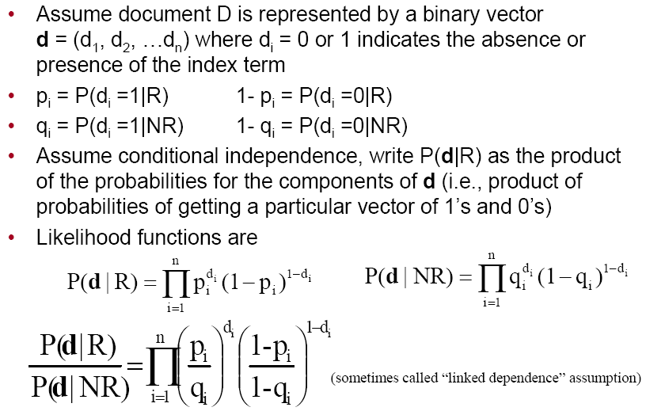
Binary Independence Retrieval (BIR)
Notes:
p_{i} and q_{i} are two independent measures, they are used to measure the probability of getting each term from Relevant document set and Non-Relevant document set.
It should be noted that, for a term, it may appear in both R and NR set, which is different from a document. For a document, it can only belong to R or NR and cannot belong to both sets.

Slide 17
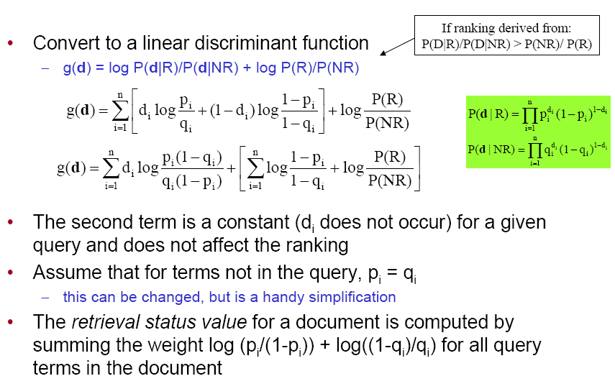
BIR (Cont’d)

Slide 18
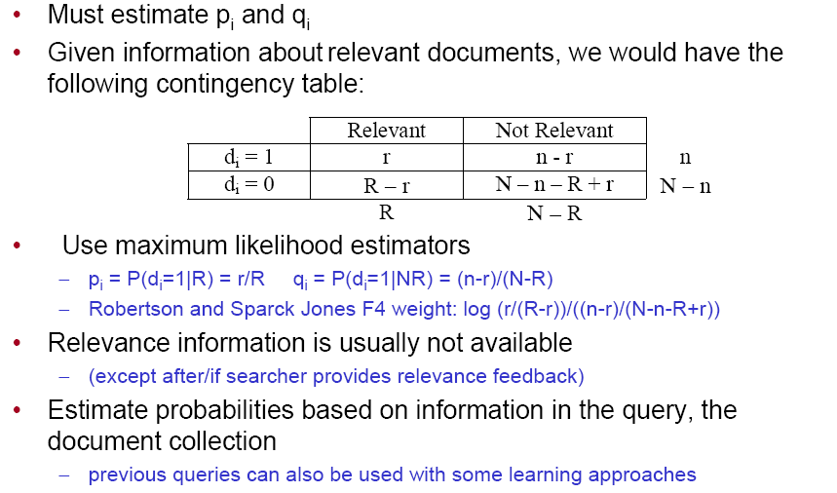
Estimation using training data
Notes:
Contingency table: 或然表

Slide 19
Estimation without training data
Initial guess, with no information to work from:
p_{i} = P(d_{i} | R) = c
q_{i} = P(d_{i} | NR) = n_{i} / N
where:
c is an arbitrary constant, e.g., 0.5
n_{i} is the number of documents that contain term x_{i}
N is the total number of documents in the collection
Why this is reasonable here?
Notes:
Most of the documents that contain x_{i} are non-relevent documents.

Slide 20
Improving the Estimation
Human feedback -- relevance feedback
Automatically
(a) Run query q using initial values. Consider the t top ranked documents. Let s_{i} be the number of these documents that contain the term d_{i}.
(b) The new estimates are:
p_{i} = P(d_{i} | R) = s_{i} / t
q_{i} = P(d_{i} | NR) = (n_{i} - s_{i}) / (N - t)

Slide 21
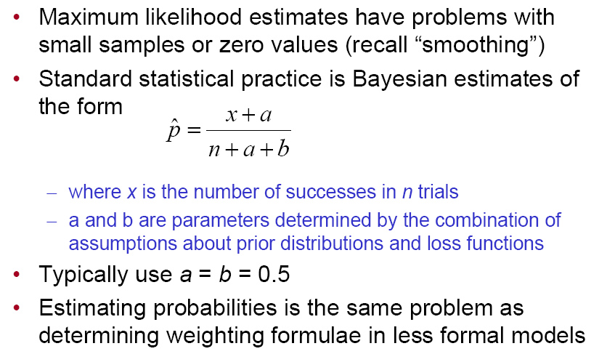
Estimation issues

Slide 22
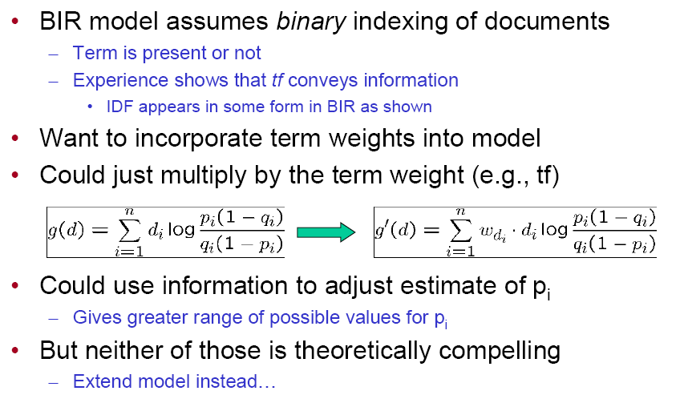
Adding more document representation

Slide 23

BM25 Weighting Ref for following pages: Stephen Robertson, Microsoft Research Cambridge, UK, CCF ADL 2011
Soft normalization factor:
Now divide tf by B before applying the saturation function
denotes the Robertson / Sparck Jones F4 weight
23
Here k₁ is just another constant.

Slide 24
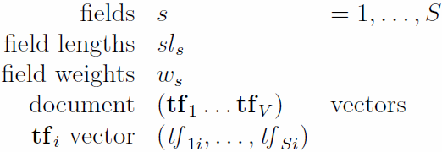
Multiple fields
Assume multiple fields (also known as streams) in documents
E.g. title, abstract, body
Basically a minimal flat structure, common to all documents
Assume also that some fields may provide better evidence about relevance than others
Would like to weight them differentially
24

Slide 25
Multiple fields
One possibility: Calculate BM25 per field and then combine
But this is not a good idea
each field calculation ignores the other fields
and in particular which terms were matched
Alternative: look at each term in turn
combine information across fields for this term
then apply saturation function
and combine across terms
Field weights as field replication
E.g. if terms in the title field should count 5 times as much as terms in the body
… then simply replicate the title field 5 times
25

Slide 26
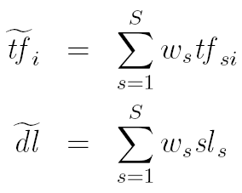
BM25F
Simplest version:
But we may want to use field-specific BM25 parameters
Could consider k₁, b, W_{i}^{RSJ}, or its non-feedback version, W_{i}^{IDF}
BM25 formula can be re-arranged to combine any or all of these with the field-specific tf
Have found it important to make b field-specific
26

Slide 27
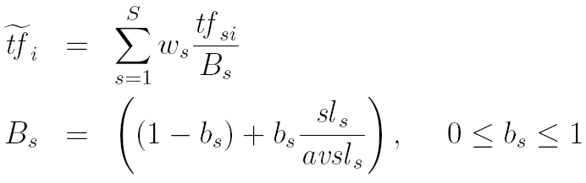
BM25F
This is the version used in TREC submissions (the CIKM paper [Robertson Zaragoza Taylor 2004] used the simpler version)
Again, in the absence of relevance feedback information, W_{i}^{RSJ} can be replaced by W_{i}^{IDF}
27

Slide 28
Homework 04
比较布尔模型、向量空间模型和概率模型，描述这三者的异同之处。
You should only submit your HANDWRITTEN deducing process. Any form of electronic document (even printed out on paper) will be REJECTED!
Due Date:

